Slide 1
EDUC2323 Computer Programming as a Tool for Learning

Slide 2
Scratch Projects for Today
Movement Example
https://scratch.mit.edu/projects/143192110/
Cloning Example
https://scratch.mit.edu/projects/143326332/
Whack-a-mole
  https://scratch.mit.edu/projects/143699447/

Slide 3
Plan
Revising the coordinate system used in Scratch
Introducing sprite cloning
  And elements of object oriented programming
A final challenge – analysing Whack-a-mole
And then… Individual work on projects

Slide 4
Scratch Stage Coordinates
Scratch uses the ‘Cartesian’ coordinate system (x,y) to position sprites on the stage.
  First number (x) gives horizontal location
  Second number (y) gives vertical location
The coordinates relate to pixels – the total area of the stage is 480 x 360 pixels:
  Values for x run from -240 to 240 (so 480 in total)
  Values for y run from -180 to 180 (so 360 in total)
The pixel in the exact centre of the stage has the coordinates (0,0).
  So values for x from -240 to -1 are to the left of the screen, and…
  … Values for y from -180 to -1 are in the lower half of the screen
You can always tell the coordinates of the mouse pointer on the screen using the readout in the bottom right corner of the Stage
By default, the coordinate of a sprite is regarded as its centre, but this can be changed in the costume editor.

Slide 5
y
x = -240
y = 180
x = 240
y = 180
x
x = 0
y = 0
x = -240
y = -180
x = 240
y = -180
http://web.eng.fiu.edu/~arellano/1002/Scratch/EGN-1002-Intro-to-Scratch-v05.pptx

Slide 6
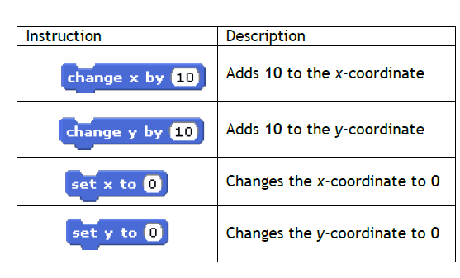
y
x = -240
y = 180
x = 240
y = 180
x
x = 0
y = 0
x = -240
y = -180
x = 240
y = -180
Here are examples of how we can relate this grid to Scratch instruction blocks. There are two types:
Relative position blocks (e.g. change by)
Absolute position blocks
(e.g. set x to)

Slide 7
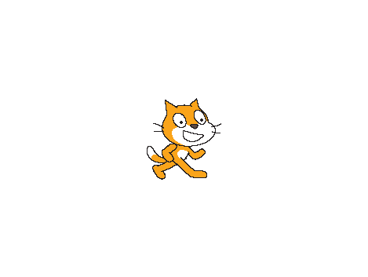
What is the position of the:
Star
Square
Triangle
Rectangle
Cat
Y-axis
180
(0, 0)
(x,y)
X-axis
-240
240
-180
https://computerscienceuk.com/wp-content/uploads/2015/03/Lesson-1-Skills-Scrolling-Backgrounds1.pptx

Slide 8
What is the position of the:
Star (-240,180)
Square (240, -180)
Triangle (-240, 0)
Rectangle (0, -180)
Cat (0,0)
Y-axis
180
(0, 0)
(x,y)
X-axis
-240
240
-180
https://computerscienceuk.com/wp-content/uploads/2015/03/Lesson-1-Skills-Scrolling-Backgrounds1.pptx

Slide 9
Using coordinates to animate and control sprite movements
Check out:
https://scratch.mit.edu/projects/143192110/

Slide 10

Let’s try something…
Step 1 – Select a single sprite and position the sprite at the left edge of the stage.
Step 2 – Move your mouse to a position on the right edge of the stage and record the x and y coordinates.
Step 3 – Add the following motion command to your sprite and enter the x and y coordinates you recorded
Step 4 – Add a green flag above this glide block
Step 5 – Click the green flag to start your program
Step 6 – After execution click the red stop button
Step 7 – Click the green flag again – What happens? Why? What’s missing?
dlupone.global2.vic.edu.au/files/2013/08/Scratch-1ekurb5.pptx

Slide 11
Introducing Sprite Cloning
https://scratch.mit.edu/projects/143326332/

Slide 12
Cloning sprites
Offers us a simple introduction to the world of Object Orientated Programming (OOP):
  Class: collection of sprite templates (e.g. cat, balloon, ball)
  Object: (a particular sprite I’ve set up in a particular way, e.g. certain looks, scripts etc – called ‘properties’) – also called a ‘parent’ sprite
  Instance: each individual clone of my sprite object –also called ‘child’ sprites
Clones ‘inherit’ the scripts, costumes, sounds and properties of the parent sprite, but can be modified separately once created
Cloning allows us to make copies of sprites while a program is running.
  A very powerful technique for projects where you need lots of the same type of object (stars, bricks, planets, bubbles) , all behaving in the same way
You can have up to 300 clones created in Scratch at any one time.

Slide 13
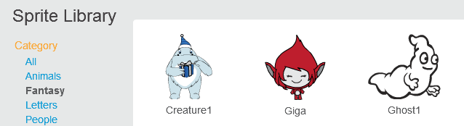
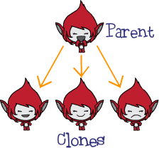
Class
Object
Instances

Slide 14
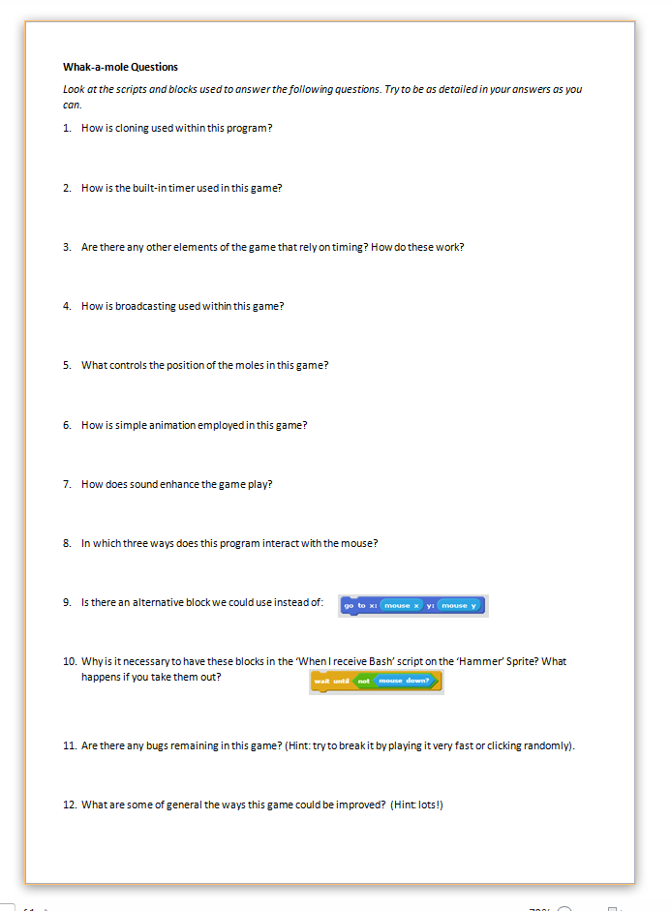
A final challenge…
Check out this simple version of Whack-a-mole:
  https://scratch.mit.edu/projects/143699447/
Grab a hard copy sheet of questions (or an electronic copy from Blackboard.
Work through these questions in as much detail as you can, checking the sprites, scripts and costumes in the project carefully.
Answering these questions accurately and in detail will confirm your understanding of lots of Scratch concepts and techniques from recent sessions…

